Slide 1
PCE as a central Controller (PCECC) Extensions
draft-zhao-pce-pcep-extension-for-pce-controller-08
draft-zhao-pce-pcep-extension-pce-controller-sr-03
Quintin Zhao | Zhenbin Li | Dhruv Dhody | Satish Karunanithi | Adrian Farrel | Chao Zhou

Slide 2
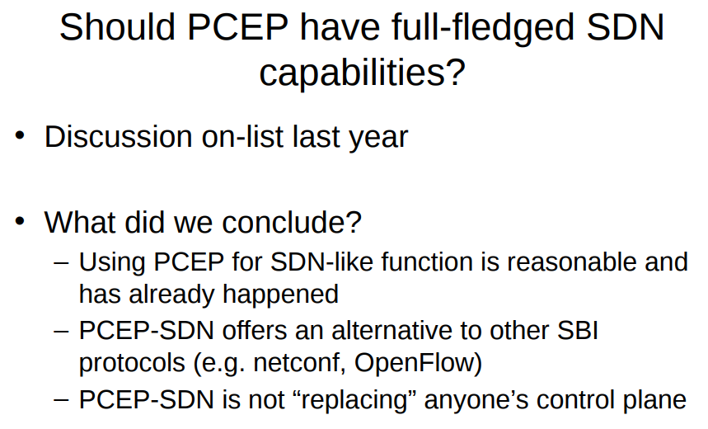
Introduction
RFC 8283 is published
Introduces the architecture for PCE as a central controller and examines the motivations/applicability for PCEP as a control protocol in this environment.
A PCE-based central controller can simplify the processing of a distributed control plane by blending it with elements of SDN and without necessarily completely replacing it.
An architecture for use of PCE/PCEP in a network with central control.
During IETF 101

Slide 3
PCE-CC Extensions
Basic
SR

Slide 4
Basic PCECC Mode

Slide 5
New functions

Slide 6
Capability

Slide 7
Synchronization and Cleanup

Slide 8
SR PCECC Mode

